Slide 1
Business Data Communications
Fourteenth Edition
Jerry FitzGerald, Alan Dennis, and Alexandra Durcikova
Chapter 8
Backbone Networks

Slide 2
Learning Objectives
Understand the Internetworking devices used in BNs
Understand the switched backbone architecture
Understand the routed backbone architecture
Understand virtual LAN architecture
Understand the best practice recommendations for backbone design
Be aware of ways to improve BN performance.

Slide 3
8.1 Introduction
Backbones used to be built with special technologies, but today most BNs use high-speed Ethernet.
There are two basic components to a BN: the network cable and the hardware devices that connect other networks to the BN.
Cable is usually fiber optic.
Switches operate at the data link layer
Routers operate at the network layer
VLAN switches are a special combination of layer 2 switches and routers.

Slide 4
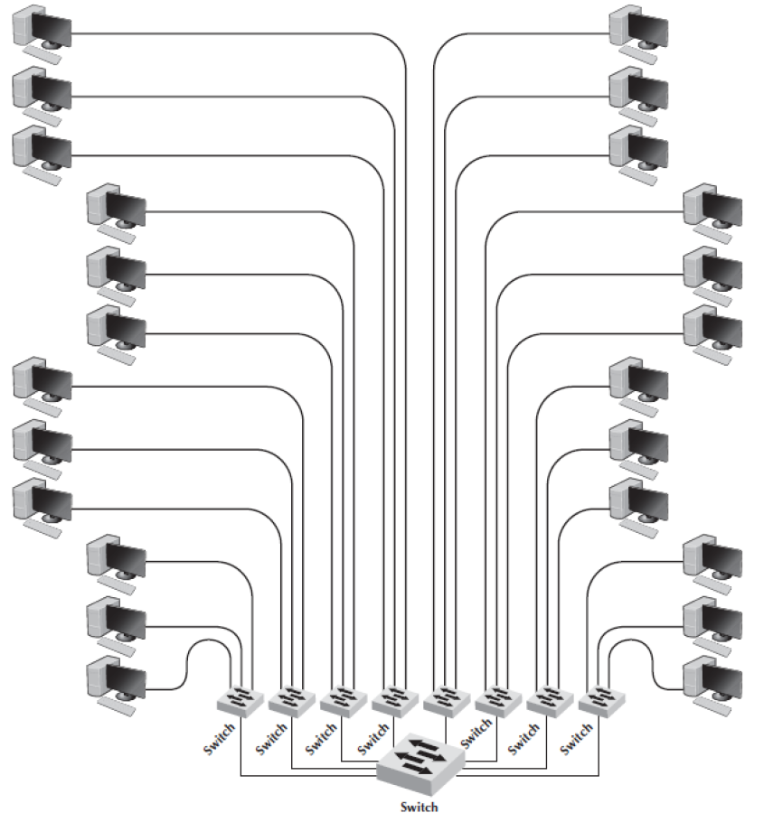
8.2 Switched Backbones
Switched backbones are the most common type of BN used in the distribution layer.
Switched BNs use a star topology with one switch at its center.
There is a switch serving each LAN that is connected to the backbone switch.

Slide 5
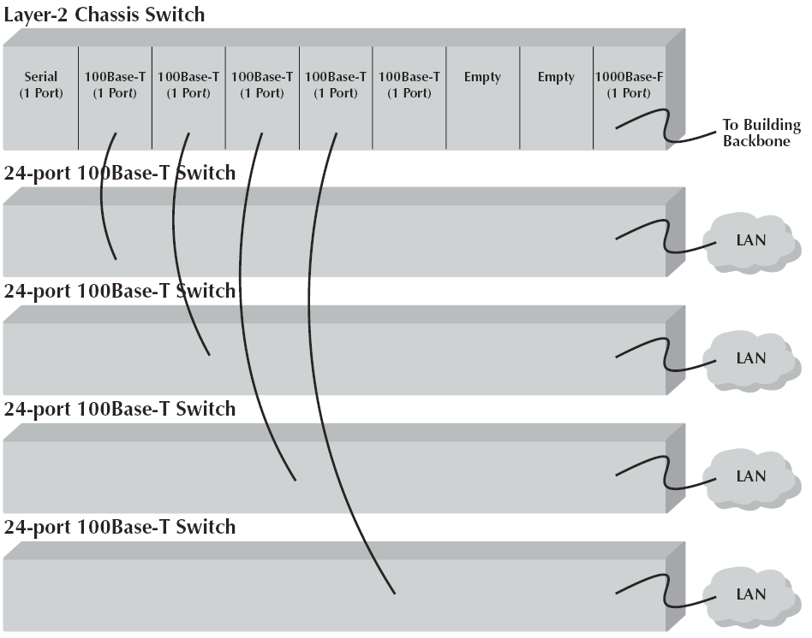
Switched Backbones Continued
Most organizations use switched backbones in which all network devices are physically located in the same room
Often in a rack of equipment
The room containing the rack of equipment is sometimes called the main distribution facility (MDF) or central distribution facility (CDF).
The devices are connected among themselves using very short cables called patch cables.

Slide 6
Main Distribution Facility
With an MDF, all cables run into the MDF\
If one switch becomes overloaded, it is straight-forward to unplug the cables and it into a less-busy switch.
Sometimes a chassis switch is used instead of a rack.
A chassis switch enables users to plug modules directly into the switch
The key advantage of chassis switches is their flexibility.

Slide 7
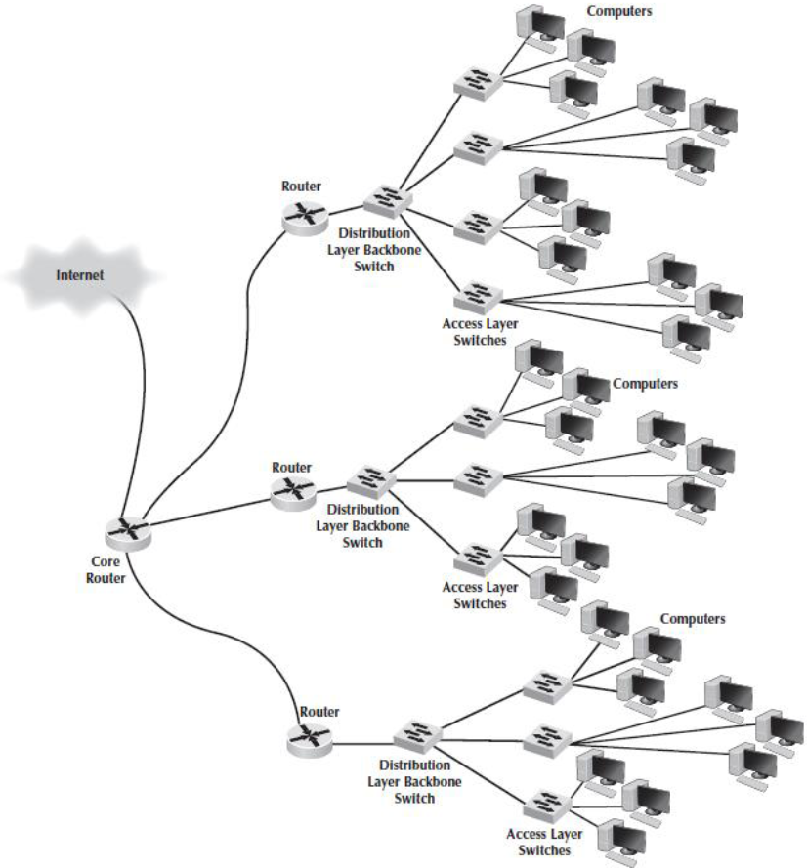
8.3 Routed Backbones
Routed backbones move packets along the backbone on the basis of their network layer address
Sometimes called subnetted backbones or hierarchical backbones
Most commonly used to connect different buildings on the same enterprise campus backbone network.
A routed backbone ensures that broadcast messages stay in the one network segment.

Slide 8
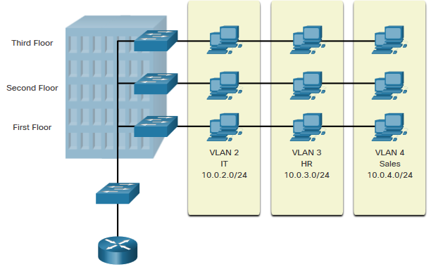
8.4 Virtual LANs
VLANs are logical connections with other similar devices.
Placing devices into various VLANs have the following characteristics:
Provides segmentation of the various groups of devices on the same switches
Provide organization that is more manageable
Broadcasts, multicasts and unicasts are isolated in the individual VLAN
Each VLAN will have its own unique range of IP addressing
Smaller broadcast domains

Slide 9
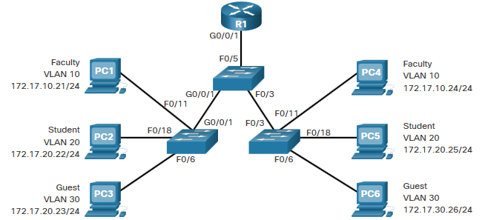
Overview of VLANs Benefits of a VLAN Design
Benefits | Description
Smaller Broadcast Domains | Dividing the LAN reduces the number of broadcast domains
Improved Security | Only users in the same VLAN can communicate together
Reduced Cost | One switch can support multiple groups or VLANs
Better Performance | Small broadcast domains reduce traffic, improving bandwidth
Simpler Management | Similar groups will need similar applications and other network resources
Notes:
3 – VLANs
3.1 – Overview of VLANs
3.1.2 – Benefits of a VLAN Design

Slide 10
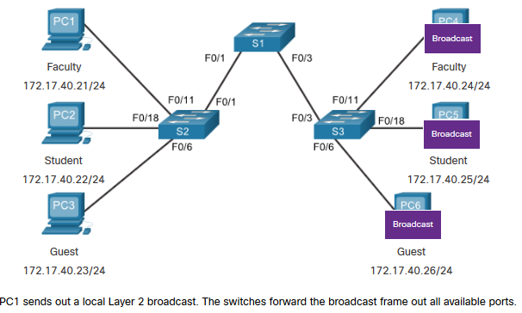
VLANs in a Multi-Switched Environment Networks without VLANs
Without VLANs, all devices connected to the switches will receive all unicast, multicast, and broadcast traffic.
Notes:
3 – VLANs
3.2 – VLANs in a Multi-Switched Environment
3.2.2 – Networks without VLANs

Slide 11
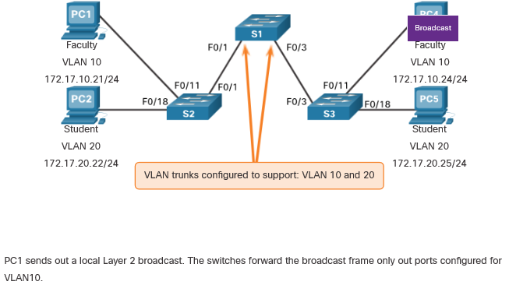
VLANs in a Multi-Switched Environment Networks with VLANs
With VLANs, unicast, multicast, and broadcast traffic is confined to a VLAN. Without a Layer 3 device to connect the VLANs, devices in different VLANs cannot communicate.
Notes:
3 – VLANs
3.2 – VLANs in a Multi-Switched Environment
3.2.3 – Networks with VLANs

Slide 12
How VLANs Work
Each computer is assigned into a specific VLAN that has a VLAN ID number
Each VLAN ID is matched to a traditional IP subnet.
Each computer connected to a VLAN switch also receives a traditional IP address assigned by the VLAN switch.
Computers are assigned into the VLAN based on the physical port on the switch into which they are connected.
When a computer transmits an Ethernet frame, it uses traditional Ethernet and IP addresses.

Slide 13
How VLANs Work Continued
Virtual LAN switches use Ethernet 802.1q tagging to move frames from one switch to another.
When a VLAN switch receives an Ethernet frame that needs to go to a computer on another VLAN switch, it changes the Ethernet frame by inserting the VLAN ID number and a priority code into the VLAN tag field
The router is a layer 3 device, so when it receives the message, it strips off the Ethernet frame and reads the IP packet.

Slide 14
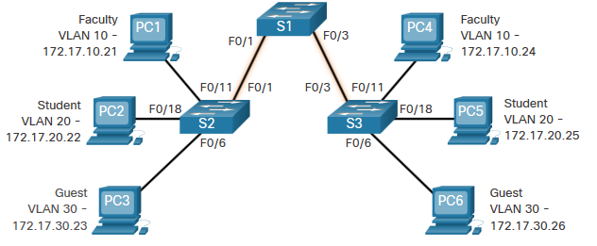
VLANs in a Multi-Switched Environment Defining VLAN Trunks
A trunk is a point-to-point link between two network devices.
Cisco trunk functions:
Allow more than one VLAN
Extend the VLAN across the entire network
By default, supports all VLANs
Supports 802.1Q trunking
Notes:
3 – VLANs
3.2 – VLANs in a Multi-Switched Environment
3.2.1 – Defining VLAN Trunks

Slide 15
VLAN Configuration VLAN Creation Commands
VLAN details are stored in the vlan.dat file. You create VLANs in the global configuration mode.
Task | IOS Command
Enter global configuration mode. | Switch# configure terminal
Create a VLAN with a valid ID number. | Switch(config)# vlan vlan-id
Specify a unique name to identify the VLAN. | Switch(config-vlan)# name vlan-name
Return to the privileged EXEC mode. | Switch(config-vlan)# end
Enter global configuration mode. | Switch# configure terminal
Notes:
3 – VLANs
3.3 – VLAN Configuration
3.3.2 – VLAN Creation Commands

Slide 16
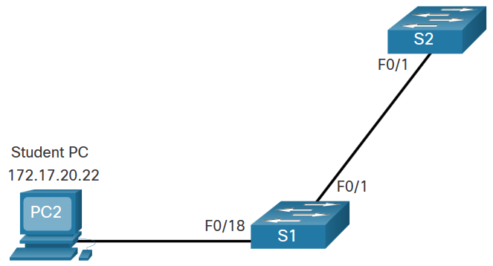
VLAN Configuration VLAN Creation Example
If the Student PC is going to be in VLAN 20, we will create the VLAN first and then name it.
If you do not name it, the Cisco IOS will give it a default name of vlan and the four digit number of the VLAN. E.g. vlan0020 for VLAN 20.
Prompt | Command
S1# | Configure terminal
S1(config)# | vlan 20
S1(config-vlan)# | name student
S1(config-vlan)# | end
Notes:
3 – VLANs
3.3 – VLAN Configuration
3.3.3 – VLAN Creation Example

Slide 17
VLAN Configuration VLAN Port Assignment Commands
Once the VLAN is created, we can then assign it to the correct interfaces.
Task | Command
Enter global configuration mode. | Switch# configure terminal
Enter interface configuration mode. | Switch(config)# interface interface-id
Set the port to access mode. | Switch(config-if)# switchport mode access
Assign the port to a VLAN. | Switch(config-if)# switchport access vlan vlan-id
Return to the privileged EXEC mode. | Switch(config-if)# end
Notes:
3 – VLANs
3.3 – VLAN Configuration
3.3.4 – VLAN Port Assignment Commands

Slide 18
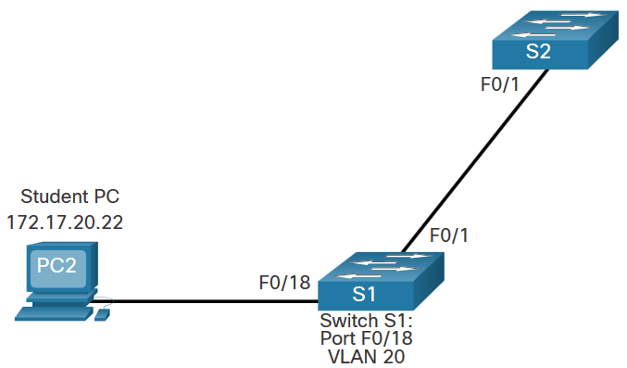
VLAN Configuration VLAN Port Assignment Example
We can assign the VLAN to the port interface.
Once the device is assigned the VLAN, then the end device will need the IP address information for that VLAN
Here, Student PC receives 172.17.20.22
Prompt | Command
S1# | Configure terminal
S1(config)# | Interface fa0/18
S1(config-if)# | Switchport mode access
S1(config-if)# | Switchport access vlan 20
S1(config-if)# | end
Notes:
3 – VLANs
3.3 – VLAN Configuration
3.3.5 – VLAN Port Assignment Example

Slide 19

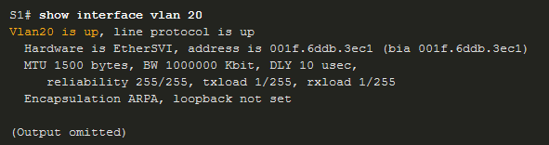
VLAN Configuration Verify VLAN Information
Use the show vlan command. The complete syntax is:
show vlan [brief | id vlan-id | name vlan-name | summary]
Task | Command Option
Display VLAN name, status, and its ports one VLAN per line. | brief
Display information about the identified VLAN ID number. | id vlan-id
Display information about the identified VLAN name. The vlan-name is an ASCII string from 1 to 32 characters. | name vlan-name
Display VLAN summary information. | summary
Notes:
3 – VLANs
3.3 – VLAN Configuration
3.3.8 – Verify VLAN Information

Slide 20
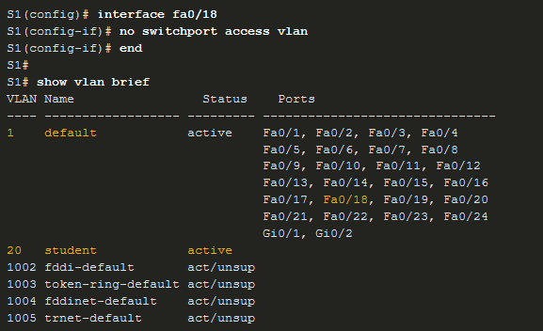
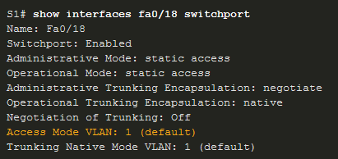
VLAN Configuration Change VLAN Port Membership
There are a number of ways to change VLAN membership:
re-enter switchport access vlan vlan-id command
use the no switchport access vlan to place interface back in VLAN 1
Use the show vlan brief or the show interface fa0/18 switchport commands to verify the correct VLAN association.
Notes:
3 – VLANs
3.3 – VLAN Configuration
3.3.9 – Change VLAN Port Membership

Slide 21
VLAN Configuration Delete VLANs
Delete VLANs with the no vlan vlan-id command.
Caution: Before deleting a VLAN, reassign all member ports to a different VLAN.
Delete all VLANs with the delete flash:vlan.dat or delete vlan.dat commands.
Reload the switch when deleting all VLANs.
Note: To restore to factory default – unplug all data cables, erase the startup-configuration and delete the vlan.dat file, then reload the device.
Notes:
3 – VLANs
3.3 – VLAN Configuration
3.3.10 – Delete VLANs
3.3.11 – Syntax Checker – VLAN Configuration

Slide 22
QUIZ 1
A backbone network is a high-speed network that connects many networks.
(TRUE/FALSE)?
Ans: True

Slide 23
QUIZ 2
A backbone network that connects many backbone networks spanning several buildings at a single location is often called an Internet backbone.
(TRUE/FALSE)?
Ans: False

Slide 24
QUIZ 3
One basic component of a backbone network is the hardware device that connects other networks to the backbone. (TRUE/FALSE)?
Ans: True

Slide 25
QUIZ 4
Routers use network layer address to forward packets between network segments. (TRUE/FALSE)?
Ans: True

Slide 26
QUIZ 5
Routed backbones use switches that move packets based on data link layer addresses. (TRUE/FALSE)?
Ans: False

Slide 27
QUIZ 6
Which of the following is not true about Layer-3 switches?
a. They switch messages based on their IP address.
b. They can be used in place of routers.
c. They function faster than routers.
d. They have more simultaneously active ports than routers.
e. They can only switch messages based on their data link layer addresses.
Ans: e.They can only switch messages based on their data link layer addresses

Slide 28
8.5 The Best Practice Backbone Design
Today, the most effective architecture for the distribution layer in terms of cost and performance is a switched backbone.
It provides the best performance at the least cost.
Many large organizations are now implementing VLANs, especially those that have departments spread over multiple buildings.

Slide 29
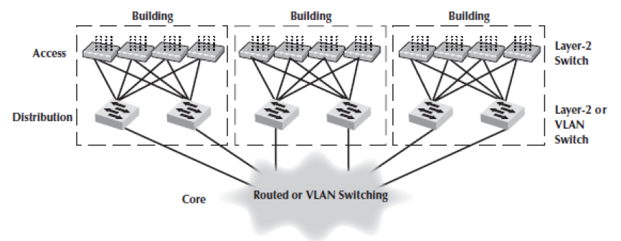
The Best Practice Recommendations
The best practice architecture is a switched backbone or VLAN for the distribution layer and a routed backbone for the core layer.
The best practice recommendation for backbone technology is gigabit Ethernet.

Slide 30
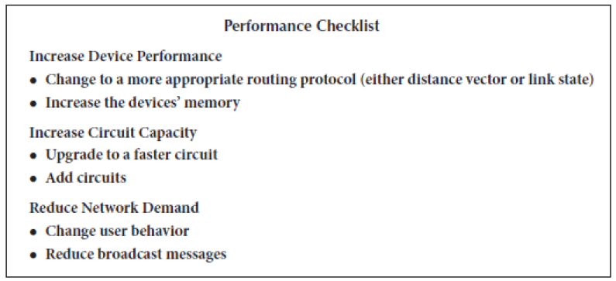
Improving Device Performance

Slide 31
8.7 Implications for Cyber Security
Most routers now have software that enables the network manager to create an access control list (ACL) that specifies what traffic the router should allow through.
Many routers have more sophisticated ACL software that enables the ACL to have different rules for different interfaces.
VLANs are the most secure type of backbone because they enable ACL and other security measures to be applied at the switch level.

